Slide 1

LARIAT REVENUE OPTIMIZATION
By Christiana Kim

Slide 2


CURRENT STATS
50 Branches
4,000 Cars
100,000 Transactions
25 Transactions Per Car
Notes:
To set the stage, let’s look over some of our current stats in 2018 to-date

Slide 3

CURRENT STATS
Gross Revenue: $64,866,040
Total Cost: $30,320,298
Net Revenue: $34,545,742
Notes:
We will use our 2018 performance as our baseline throughout this presentation.
Note: Throughout this presentation, you will hear me use the terms ‘net revenue’ and ‘profit’ interchangeably

Slide 4
OBJECTIVE
Maximize revenue
Minimize costs
Notes:
Given our current landscape, there are opportunities to optimize our rental fleet with the goal of maximizing revenue and minimizing costs

Slide 5
OPTIMIZATION STRATEGIES
1. Remove unprofitable cars
2. Add additional units of top performers
3. Increase price for BOTTOM performers
Notes:
I’ve prepared 3 different strategies in order to accomplish our goal –
Here’s a brief overview before I explain each one in more detail

Slide 6
STRATEGY 1: REMOVE UNPROFITABLE CARS
Car’s net revenue less than or equal to $0 → Unprofitable
29 unprofitable cars

Slide 7
STRATEGY 1 PROJECTIONS
From the 2018 Baseline:
Gross revenue: -0.3%
Costs: -0.8%
Net revenue: +.1%
(Volume: +$27k)
Note: The chart axis starts at $32 million for visibility in the comparison between bars

Slide 8
STRATEGY 2: ADD ADDITIONAL UNITS OF TOP PERFORMERS
Car’s profit margin greater than 75% → Top Performer
24 top performers
Add 1 identical unit of each

Slide 9
STRATEGY 2 PROJECTIONS
From the 2018 Baseline:
Gross revenue: +1%
Costs: +0.5%
Net revenue: +1.4%
(Volume: +$482k)
Note: The chart axis starts at $32 million for visibility in the comparison between bars

Slide 10
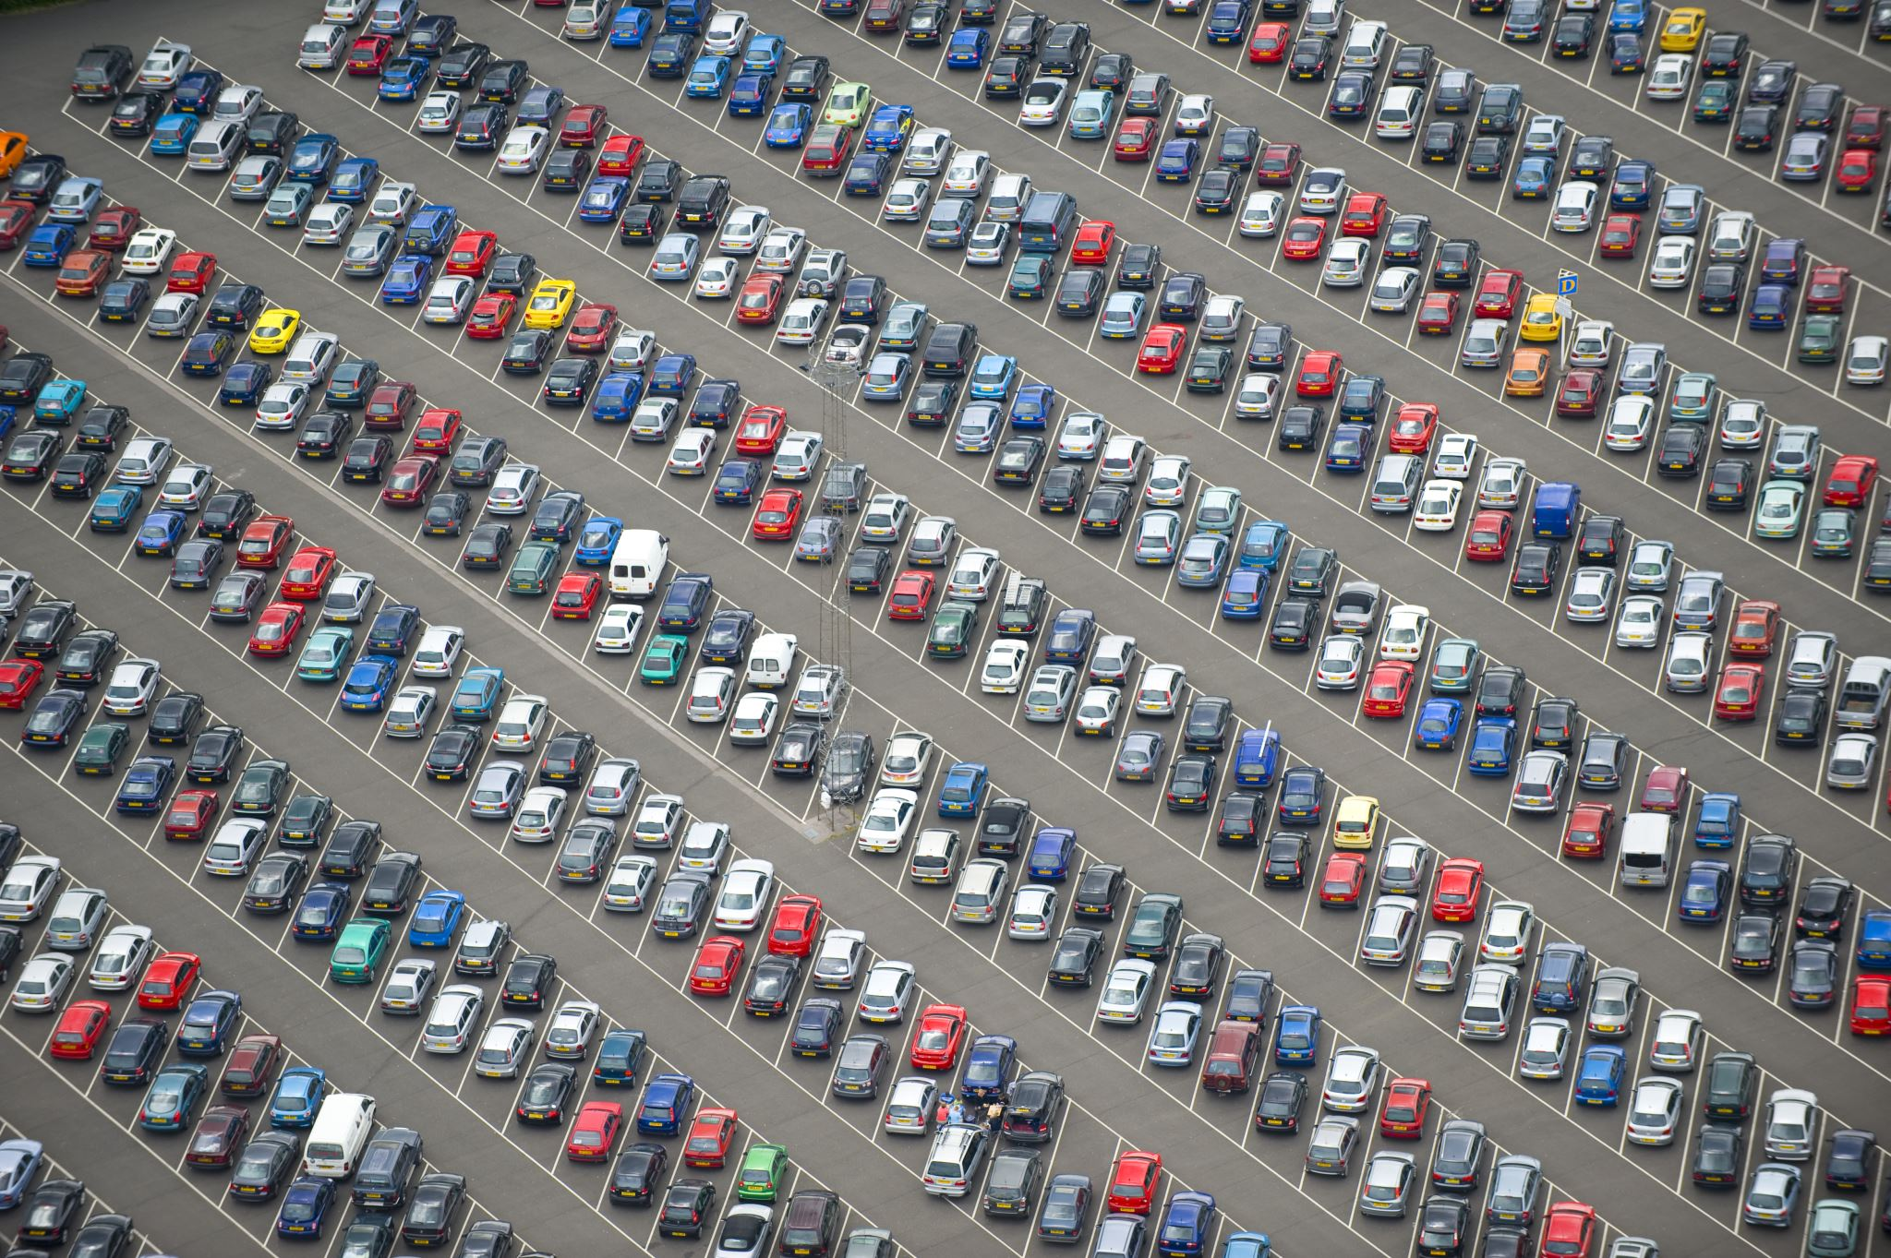
STRATEGY 3: INCREASE PRICE FOR BOTTOM PERFORMERS
Car’s profit margin less than 25% → Bottom Performer
214 bottom performers
Increase price by 25%
Assume number of transactions per car stays the same

Slide 11
STRATEGY 3 PROJECTIONS
From the 2018 Baseline:
Gross revenue: +0.8%
Costs: +0% (no change)
Net revenue: +1.5%
(Volume: +$527k)
Note: The chart axis starts at $32 million for visibility in the comparison between bars

Slide 12
COMBINE STRATEGIES?
All 3 strategies improve our bottom line
Would combining our strategies also be effective?
Notes:
In review, all 3 strategies improve our bottom line from our 2018 baseline performance

Slide 13
COMBINED STRATEGY:
Remove unprofitable cars
Add additional units of top performers
Increase price for BOTTOM performers
(EXCLUDING UNPROFITABLE CARS)
Notes:
Let’s review our 3 strategies again. This time, we will implement these ideas collectively

Slide 14

COMBINED STRATEGY PROJECTIONS
From the 2018 Baseline:
Gross revenue: +1.3%
Costs: -0.4%
Net revenue: +2.8%
(Volume: +$979k)
Note: The chart axis starts at $32 million for visibility in the comparison between bars

Slide 15
PROFIT COMPARISON
Note: The chart axis starts at $32 million for visibility in the comparison between bars
The Combined Strategy projects the highest profit increase.
Notes:
Note: for the purposes of comparing the difference in profits of each strategy here, the axis will start at $32 million.
The combination strategy best optimizes both revenue and costs to yield the highest profit increase.

Slide 16
RECAP & RECOMMENDATION
Goal: Maximize revenue, minimize costs
Baseline: 2018 Performance
Strategy 1: Remove unprofitable cars
Strategy 2: Add additional units of top performers
Strategy 3: Increase price for bottom performers
While each unique strategy independently improves net revenue, using the combined strategy is recommended as it decreases cost, increases revenue, and yields the highest profit.

Slide 17
THANK YOU

